Slide 1
HHSOM Faculty Meeting
7 February 2017

Slide 2
Agenda
8:30 – 9:00 HHSOM business and announcements
9:00 – 9:30 Tenure-track and tenured professors
Faculty Search Matters

Slide 3
Business
Chris Hallum, undergraduate admissions
Sara Emery, development
Amy Pollard, performance coordinator
Pete Jutras, associate director research and graduate studies
Brandon Craswell, undergraduate coordinator
Notes:
Amy: speakers for alumni meetings
Pete: New seed-grant funding, TA budget, overworking TAs.
Brandon: Scholarships
Chris Hallum: students and notecards, ambassadors
Sara Emery: The UGA Alumni Association is creating a speakers list for alumni chapters throughout the US. Faculty and administrators interested in serving as a guest lecturer (including recitals, lecture recitals, etc.) should contact Sara to learn more about this opportunity. (Sara has followed this announcement up with an email on this topic).
Chris Hallum: Nominations will soon be open for HHSOM Undergraduate Student Ambassador program. Student ambassadors support the school in recruiting, admissions and development. Chris hopes to have students from a variety of areas within the School, so please consider nominating top students from your areas. Chris also reminded faculty of the importance of providing letters of support for student admissions files (these should be sent to Chris) in as timely a manner as possible. These are very helpful in getting students through the UGA admissions process. Also, faculty are encouraged to keep in touch with prospective recruits throughout the process.
Pete Jutras: The budget for TAs for the upcoming academic year has very little room for the general recruiting pool, the result of a reduction in funds from external sources, as well as UGA requirements for salary participation by the HHSOM. Strong candidates who are well qualified for musicology or theory assignment areas may be considered for support. UGA’s ICE initiative also has graduate assistantships. A small group of students may qualify for Out of State waivers (including international students). Faculty with TAs assigned to them are asked to be reasonable in expectations of the time commitments for the TA duties. There have been concerns brought to the administration by TAs about being overworked and worries about receiving strong reference letters if they complain. TAs should not be expected to go beyond the weekly hours assigned.
President’s Interdisciplinary Seed Grant Program (https://research.uga.edu/research-announcements/2017/01/25/presidents-interdisciplinary-seed-grant-program-announced/): new internal seed grant program seeking interdisciplinary proposals in five area, two of which should apply to the area of music: enhancing global health and well-being and building vital and prosperous communities. Interested faculty should contact Pete a.s.a.p. as initial letters of intent are due Feb. 28. OVPR is also a resource for pursuing federal grants. Again, contact Pete to learn more.
Brandon Craswell: Area chairs now have the scholarship budget lists. Scholarship offer sheets should be turned in by Feb. 28. Names of students who may need a special admit or waiver need to be turned in, as well. These students must be on scholarship, as well. Please include a statement on each student on why this is an important admit request.

Slide 4
Brief Announcements
McCay Grants 2017-18: send proposals and budgets to Pete Jutras
1-time grant proposals under deliberation
$1 million available, $3.5 million in requests
Area Chair Council discussion, student meeting
Convocation graduation speaker
Please consider names and forward them to Dale
When performers / alumni come to campus, inform us please
Notes:
One-time grants: proposals have been reviewed by Area Chairs and students were invited to give input at a Student Advisory Council meeting. They are now with Dale for the next phase of review.

Slide 5
Brief Announcements
HHSOM Teaching Awards
Guidelines forwarded mid-December
Due February 15
2016 Performance Reviews
Interviews:
Untenured
Those anticipating promotion in next 3 years
Any others who would like to speak with Director
Notes:
HHSOM Teaching Awards: guidelines were resent following the faculty meeting.

Slide 6
a2ru– Alliance for the Arts in Research Universities
The Alliance for the Arts in Research Universities (a2ru) generates knowledge, advocacy, and resources that enable universities to integrate arts and design practices, fostering highly adaptive creators and thinkers.
Notes:
A2u: UGA joined this national arts research consortium in the fall and anticipates hosting the national conference at UGA within the next few years. Faculty are encouraged to learn more about this partnership and consider how to become a part of it (https://willson.uga.edu/research/research-clusters/alliance-for-the-arts-in-research-universities-a2ru/)

Slide 7
A2RU – Alliance for the Arts in Research Universities
Arizona State University
Boston University
Carnegie Mellon
Dartmouth College
Iowa State University
James Madison University
Johns Hopkins University
Kent State University
Louisiana State University
Massachusetts Institute of Technology
Michigan State University
Northeastern University
The Ohio State University
Pennsylvania State University
Princeton University
Texas Tech University
Tufts University
The University of Alabama
The University of Alabama at Birmingham
The University of Arizona
University of Cincinnati
University of Colorado Boulder
University of Colorado Denver
University of Florida
University of Georgia
University of Houston
University of Illinois at Urbana-Champaign
The University of Iowa
University of Michigan
University of Nebraska-Lincoln
University of North Texas
The University of Utah
The University of Virginia
University of Wisconsin-Madison
Virginia Commonwealth University
Virginia Tech
Washington University in St. Louis

Slide 8
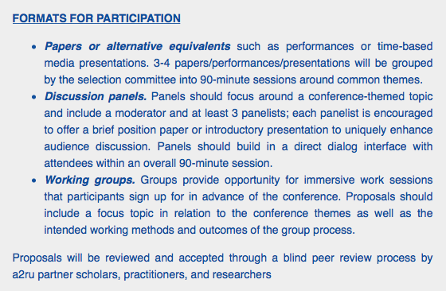
A2RU – Alliance for the Arts in Research Universities
Conference
April 7 conference at Northeastern U, Boston U, MIT, Tufts
“Arts in the Public Sphere: Civility, Advocacy, and Engagement” - Boston
Notes:
UGA will likely host in next 2-3 years.

Slide 9
Franklin Faculty Senate Nominees
Josh Bynum
University Council
Milton Masciadri (also Facilities Committee)
Notes:
Josh Bynum was re-elected to serve on the Franklin Faculty Senate for another three year term.
Maggie Snyder will serve on the University Council for another three year term.

Slide 10
Curriculum Revisions, etc.
Career Center Search Committee named this week
Course schedule for fall
Jazz: minor vs. certificate
Performance certificate
“Double Dawgs”
Other ad hoc discussion groups for long-term change
Notes:
Jazz Minor: The Jazz Minor is now available for SOM music students, but there can be no duplication of classes between the Minor and Major degrees. For this reason, the School will also look in to a certificate program, which would allow for cross counting of classes between the Major and Certificate.
Performance Certificate is still in the development stage.
Double Dawgs are students who earn a bachelor’s degree and a masters degree in 5 years. Ideas on how this might work for Music majors should be sent to day.

