Slide 1
Faculty Meeting
8 December 2016

Slide 2
Agenda
Introductions
Announcements
Business
Administration reports
Searches: staff and faculty
Faculty and staff annual evaluations
Scheduling issues
Financial matters
Admissions, recruiting, scholarships

Slide 3
Announcements
Convocation speaker sought
Reminder: Assessment process

Slide 4
Reports
Pete Jutras, Associate Director
Martha Thomas, Associate Director
Amy Pollard, Performance Coordinator
Brandon Craswell, Undergraduate Coordinator
Notes:
Pete Jutras: Nominations for Presidential Fellowships are due January 12. Any new admits must be through the acceptance process by then to be considered.
Amy Pollard: X Week overview: 24 faculty signed up so far, totaling 142 lessons. All areas are represented. There is still time to volunteer. An email will be sent out to students with the information on the lessons and times available, as well as instructions on how to participate. If there is a shortage in a certain area, Amy will follow up with that area to see if more slots can be made available.
The Streaming guidelines have been updated to reflect both the need for streaming and the availability of staff to provide the service (see green handout or on Maestro-Faculty Information and Maestro-Student Information). Check the guidelines for single and multi-camera streaming protocols and fee structures for faculty, students, guest artists and outside events. Faculty who would like to have more than one multi-camera stream in a one-year period must petition for this exception. Students are only allowed a fixed-angle camera stream. Guests (or their faculty hosts) can receive a fixed-angle stream for a fee. In all cases, streaming requests must be made at least two weeks in advance of the event; outside events should schedule streaming at least three weeks in advance.
Sounds Across Athens – This is a new event scheduled for April 1, 2017 and will feature a full day of musical performances by students (voluntary) throughout the Athens area. The goal is to bring music into the community, thereby engaging a larger audience. Participating students will be involved in all aspects of the project, giving them planning and promotion experience along with a performance opportunity. Students will also be encouraged to choose a charity and collect donations as part of the event, giving them the opportunity to be involved in a philanthropic activity. A yellow handout was presented at the faculty meeting and put in mailboxes of absent members. More information will be sent out to students and faculty.

Slide 5
Searches
Faculty Positions
Assistant Professor, tenure track Music Ed
Assistant Professor, limited term Composition
Assistant Professor, tenure track Piano
Staff Positions
Band Assistant
Career Center Director
Notes:
Searches for faculty positions are ongoing. Committees are now narrowing the searches to semi-finalists. The School hopes to have candidates on campus in early spring semester.
Band Assistant search – the School will be hiring a new assistant for the Band area to replace Rebecca Yardley, who accepted a position outside of UGA. A temporary employee may be hired while HHSOM works with Franklin College and HR for a reclassification of the position for hiring.
Career Center director search – this will be conducted during the spring semester.

Slide 6
Faculty and staff evaluations

Slide 7
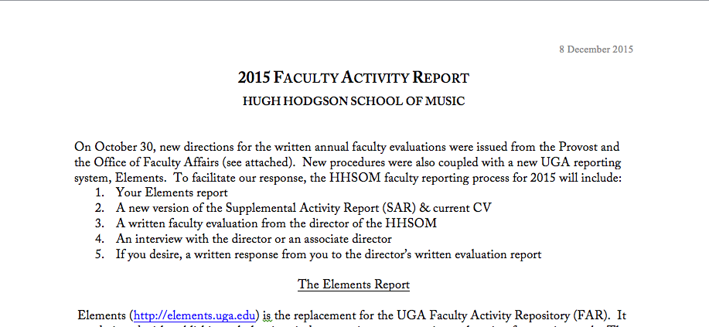
Faculty and Staff Evaluations
See Handout
Notes:
The Faculty Evaluations process will be the same as last year; guidelines will be sent out. New this year is the requirement to apply the Promotion and Tenure Unit Criteria to annual reviews. This new set of annual guidelines must be sent to Franklin now. Dale received comments on the creative/scholarly criteria from one area but would like to hear from others. Since the creative/scholarly sections are unique to each area, discussions focused on the teaching criteria and mainly the application of the meets/exceeds expectations categories. Questions were asked about appropriate technology (this would be different for each person, depending on the area of teaching), motivating students to complete teacher evaluations (suggestions included doing the evaluation process during class time, dropping one homework grade), how workshops on teaching would be applied (teaching or scholarly; Dale will clarify). The primary concerns were with the proposed meets/exceeds expectations designations and the related criteria. Of particular concern was that the exceeds expectations criteria were largely externally focused (awards, etc.). Dale was open to ideas and encouraged faculty to follow up with additional suggestions.
The faculty also discussed how to quantify how faculty responsibilities are actually divided verses the standard teaching-research of 67 percent teaching to 33 percent creative/scholarly. The national standard is 40 percent teaching, 40 percent creative/scholarly and 20 percent service. After some discussion, the final suggestion to be forwarded to Franklin College was for Music: 60 percent teaching, 30 percent creative/scholarly and 10 percent service. This is just an average and varies for each faculty member.

Slide 8
Questions on 2016 activity reports?

Slide 9
Scheduling Issues
AY18
Notes:
Final drafts for AY18 will be coming out soon.

Slide 10
Financial matters

Slide 11
Financial Matters
One-Time Grants
Notes:
Proposals have come in for both equipment and new programs. These will be sent to Area Chairs, which will meet to discuss and to provide recommendations to Dale. Final decisions will be made by Dale.

Slide 12
Financial Matters
Budgeting system
Notes:
Laura Boswell has been on leave due to health-related issues. The Accounting Area will get budgets current as soon as possible.

Slide 13
recruiting, Admissions, scholarships
Notes:
General questions and comments made before going in to specifics on recruiting:
Request for status report on an Alumni Committee: A couple of faculty members volunteered to serve on this committee. It was brought up along with discussions of the Career Center, which is in the very early stages of development. More to come.
Study Abroad: Music students who are interested in participating in the Italy Study Abroad Program should apply soon. The program is getting lots of applications for non-music students and non-UGA students. Spaces are limited so HHSOM students should not delay in applying for a spot.

Slide 14
Recruiting
Faculty Discussion
Statistics
Notes:
HHSOM recruiting and acceptances have held steady over the past couple of years. In an effort to provide support for recruiting, Dale will be inviting faculty members to give brief talks at faculty meetings on their own recruiting efforts, with the goal being to share suggestions and ideas. David Zerkel was the first to present how he handles recruiting. He breaks it into three “seasons:” before you even know the students, once they are in Decision Desk, and then once they have been accepted to UGA/HHSOM.
Before you even know the students: Have a strong web presences with information for perspective students, with info/links to UGA, application process, what current and past students are doing, links to student performances (with permission of the student) and faculty performances; be in contact with pees; use social media like Facebook and Twitter.
Once in Decision Desk: Contact students and thank them for their interest; ask if they have questions; touch base every two to three weeks. At the Audition: take time to talk about UGA, their goals, etc. During his auditions, Dave spends roughly 60 percent of the time with the audition and 40 percent of the time talking with the student. This helps you and them determine if this will be a good fit; students appreciate the interaction. If he is really interested in the student, Dave lets them know right then verses waiting until the end of the audition process, which could be some weeks. Be honest about scholarships and what percent of the scholarship budget will be directed to that student. Let them know you would do more if you could. Put students in touch with other students in the studio.
Once they have been accepted to UGA/HHSOM: Contact students approximately every 10 days. Don’t bad-mouth the competition. Sell yourself and your studio; show demonstrable interest in the student.
From faculty discussions that followed the presentation: For students who are not accepted or are on a waitlist, give them suggestions on ways to improve their application/audition, etc. Cindi Johnston Turner invited faculty to bring recruits to ensemble practices, if this will help with recruiting. Dave and Michael Heald suggested staying in contact with music educators (in schools and private teachers) within the state.
Please let Dale know if you are interested in sharing your recruiting ideas at future faculty meetings.

Slide 15
Recruiting
Professional standards on recruiting
Cannot lure students away from another campus.
Students are obligated after a certain date. If they change after that, permission is required.
April 15 graduate students
May 1 undergraduates

Slide 16
Admissions
Director UG Admissions Patrick Winter
Helpful pattern established last year
Special admits
Do NOT say, “We have special admits and can get you into UGA.”
DO say, “Talent will be heavily considered. I will write a personal recommendation for your file.”
Out-of-state waivers
Notes:
Letters of support for students is very helpful. January 15 is the official date to get letters in, but letters can be added past this date and until a students file has been read by UGA admissions. Chris Hallum closely monitors this process which goes through mid-March (approximately) and he does get confirmation from the admissions office that the letter has been added to a student’s file.
Out-of-state waivers: these can not be offered to transfer students. They are for incoming freshmen who are US citizens, are not part of the special admits process and who have a scholarship through Music or other area. Out-of-state waivers for international students (UG and graduate) is a different process and occurs much earlier in the process than the general out-of-state waivers.

Slide 17
Scholarships & Assistantships
Almost exponential growth
We will try to be helpful
Scholarship growth
TAs close to 100 – we cannot grow
Questions or concerns?
Notes:
There will be no “new” money from the Miller endowment or huge leap in scholarship funding from this or other sources. Scholarships will be at or close to current levels of support.

Slide 18
Have a wonderful holiday season!

